Slide 1
Disclaimer
We hope you find the information on our website and resources useful.
Animations
This resource has been designed with animations to make it as fun and engaging as possible. To view the content in the correct formatting, please view the PowerPoint in ‘slide show mode’. This takes you from desktop to presentation mode. If you view the slides out of ‘slide show mode’, you may find that some of the text and images overlap each other and/or are difficult to read.
To enter slide show mode, go to the slide show menu tab and select either from beginning or from current slide.
You may wish to delete this slide before beginning the presentation.

Slide 3


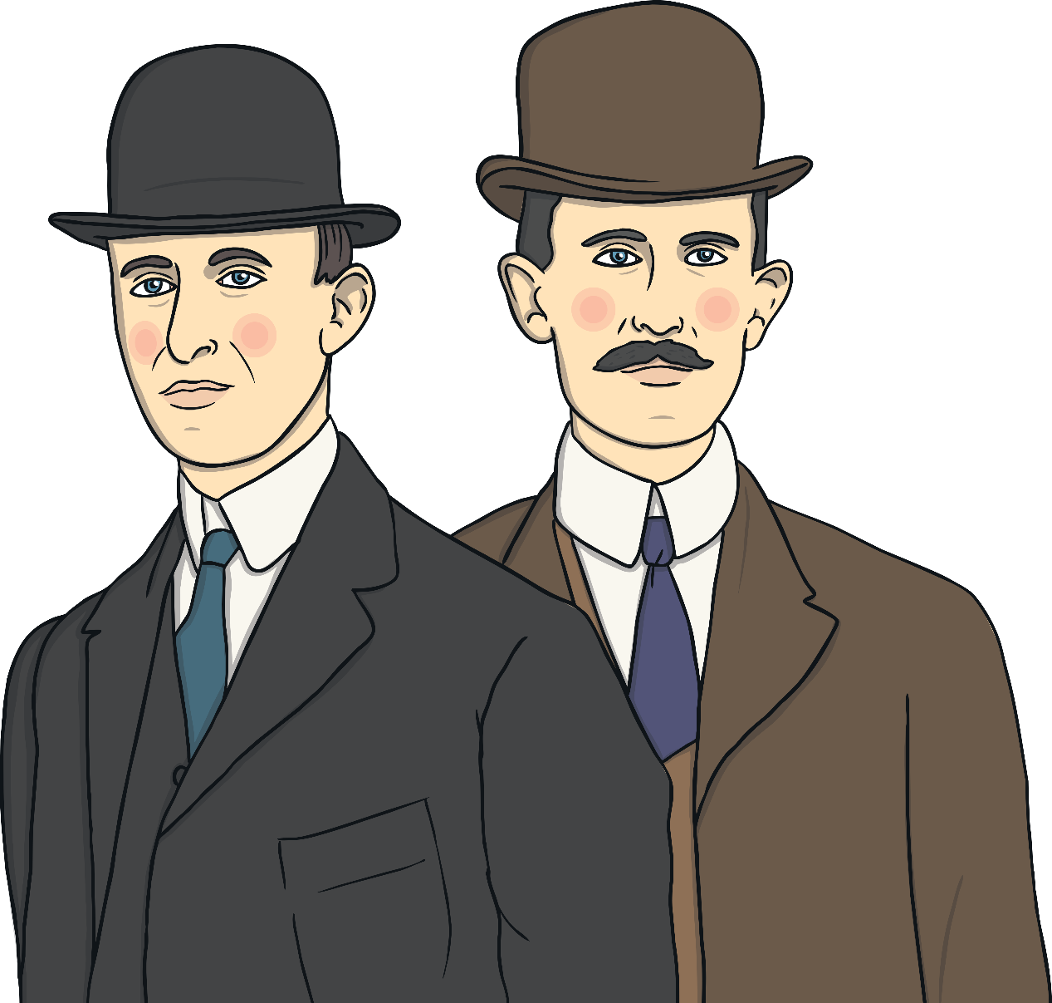
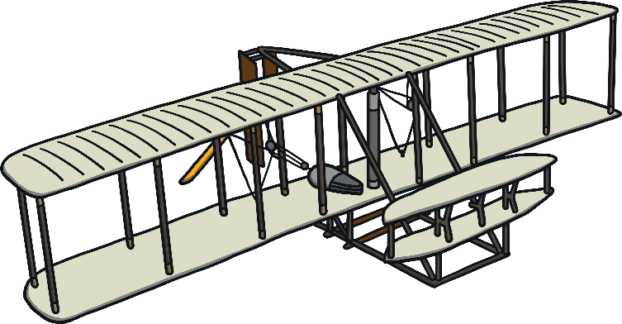
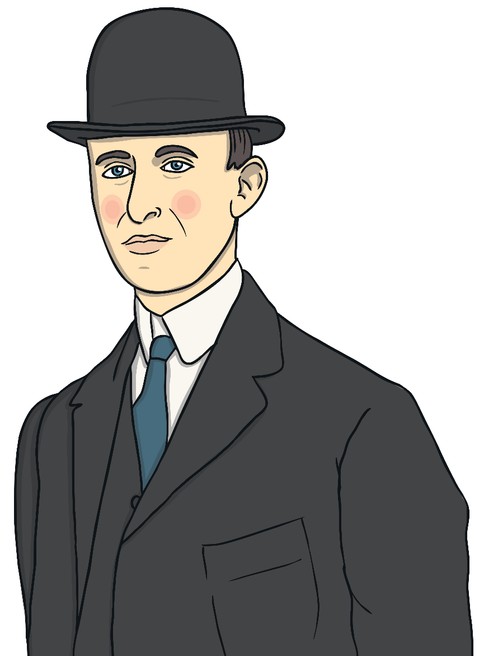
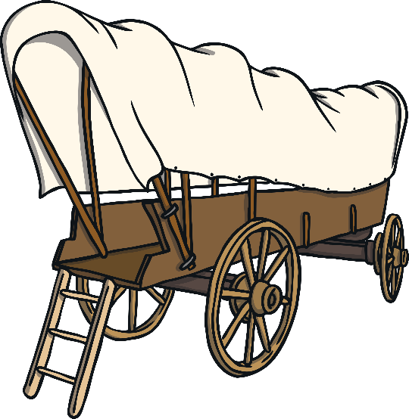
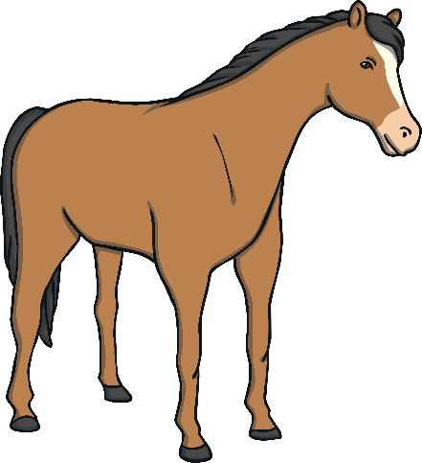

Who Were the Wright Brothers?
Who Were the Wright Brothers?
Nowadays, aeroplanes are a popular mode of transport. Before the Wright brothers’ aeroplane, the most popular way to travel was by horse and cart. Boats and trains were more common choices for longer distances.
The work of the Wright brothers have made it easier and quicker for many people to travel around the world.
Orville and Wilbur Wright were inventors who made the world’s first successful aeroplane flight in 1903.

Slide 4

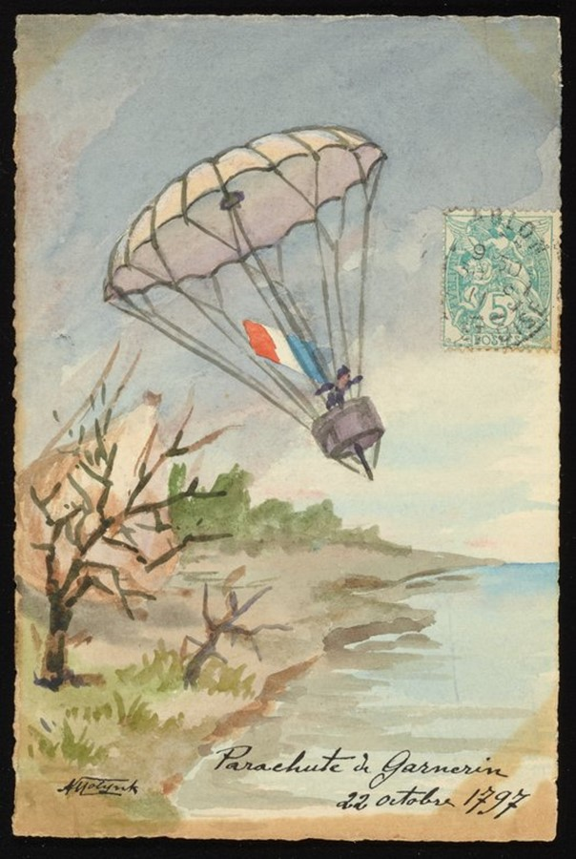




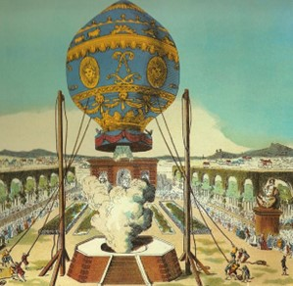
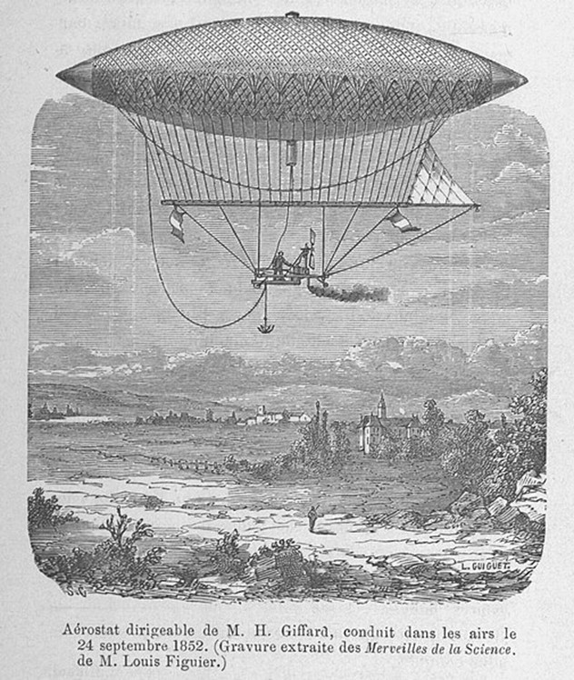
History of Flight Before 1903
History of Flight Before 1903
1797
1903
1867
First modern-day parachute jump
Wilbur Wright born
First flight of
an aeroplane
1700
1800
1900
2000
1783
1852
1871
Orville Wright born
First flight of a hot air balloon
First airship

Slide 5

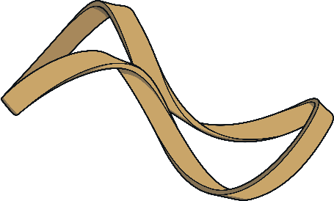
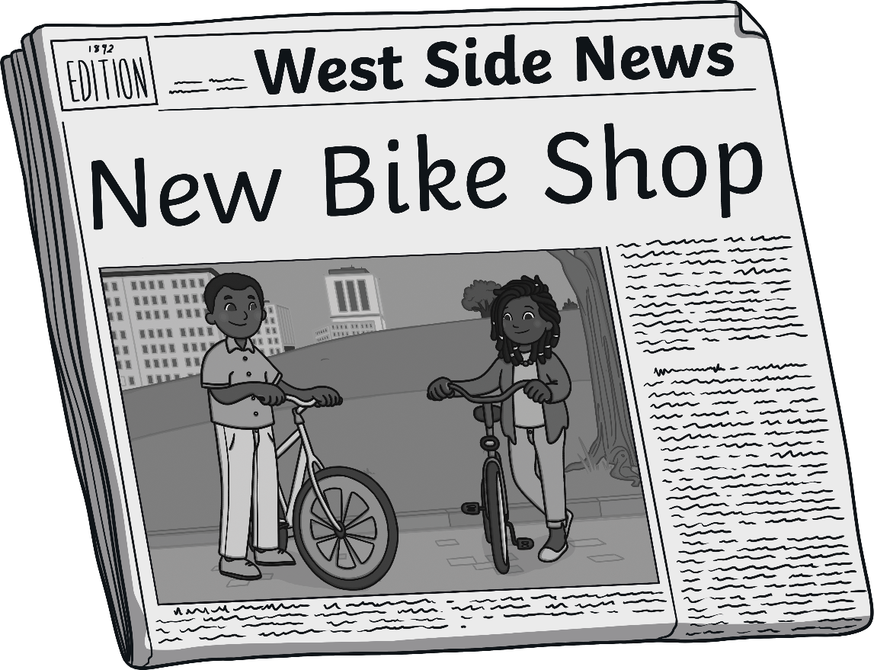
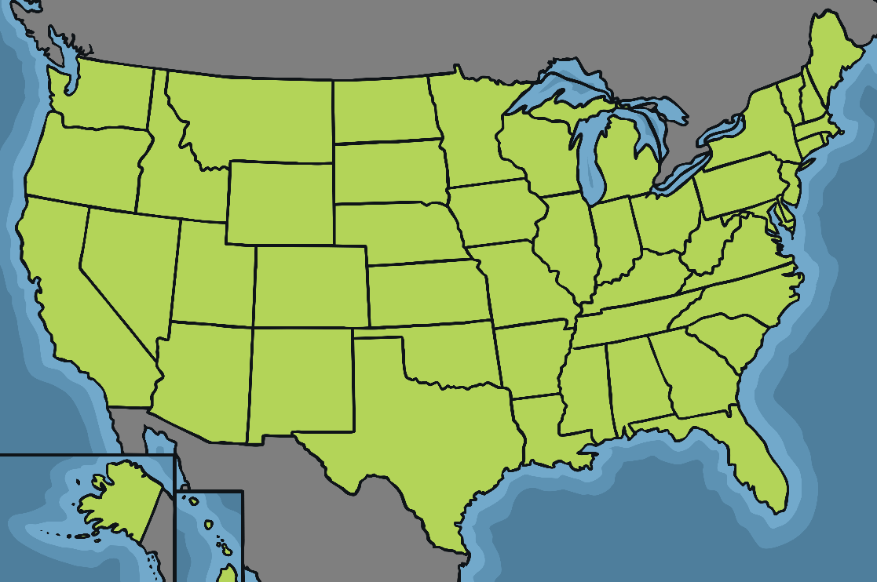
Early Life
Early Life
The Wright brothers grew up in Ohio, which is in the United States. As children, they loved to find out about the world around them and how things worked.
Wilbur and Orville first started working together when they created their own newspaper called the West Side News.
Orville was the editor and Wilbur was the publisher.
In 1892, the brothers also opened
up their own bike shop. Here, they helped to fix old bicycles and even created their own designs. However, during this time, they never forgot their love of flying.
Their love of flying began after their father gave them a small toy helicopter, which used elastic bands to twirl the propeller blades.
×
propeller - A device with two
or more large, flat blades which spins to help an aircraft or boat move forward.
Talk About It
How do you think their early life helped them to create the first flying aeroplane?

Slide 6

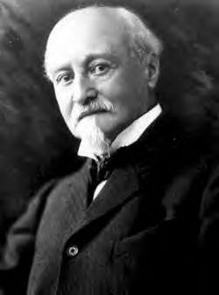



Learning to Fly
Learning to Fly
The Wright brothers were the only members of their family to not go to college.
Instead, they taught themselves all about the study of flight through reading library books and regularly asking the engineer and flight expert, Octave Chanute, for advice.
Octave Chanute

Slide 7


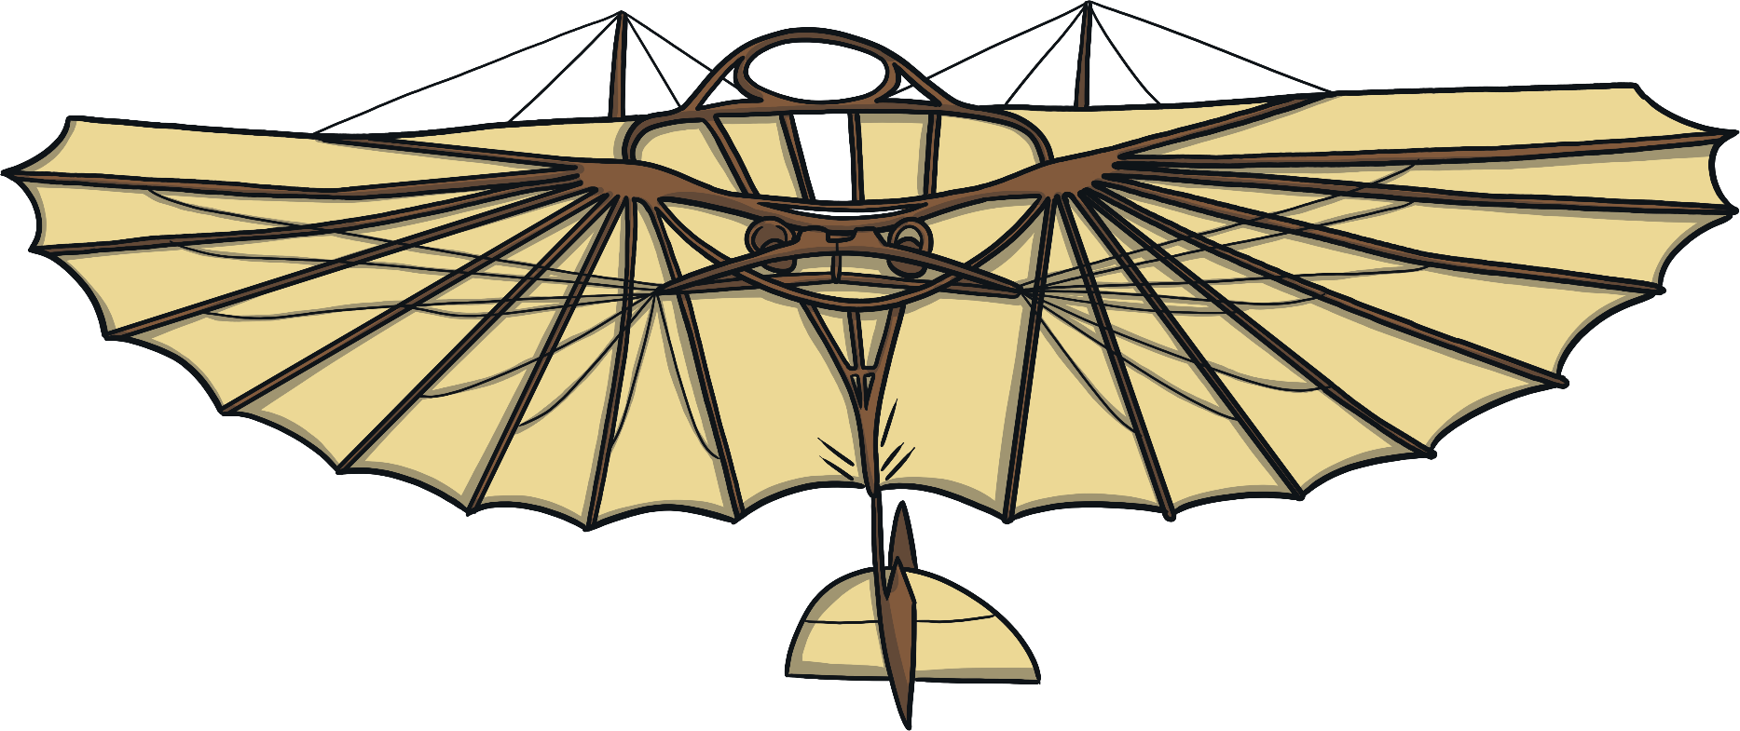
Improving Flight
Improving Flight
Before the Wright brothers started inventing aeroplanes, people had already managed to fly light aircrafts without engines, which were called gliders.
They knew that an engine would help them to power their plane further.
However, the Wright Brothers knew that to make human flight more successful, they needed to improve the design.

Slide 8
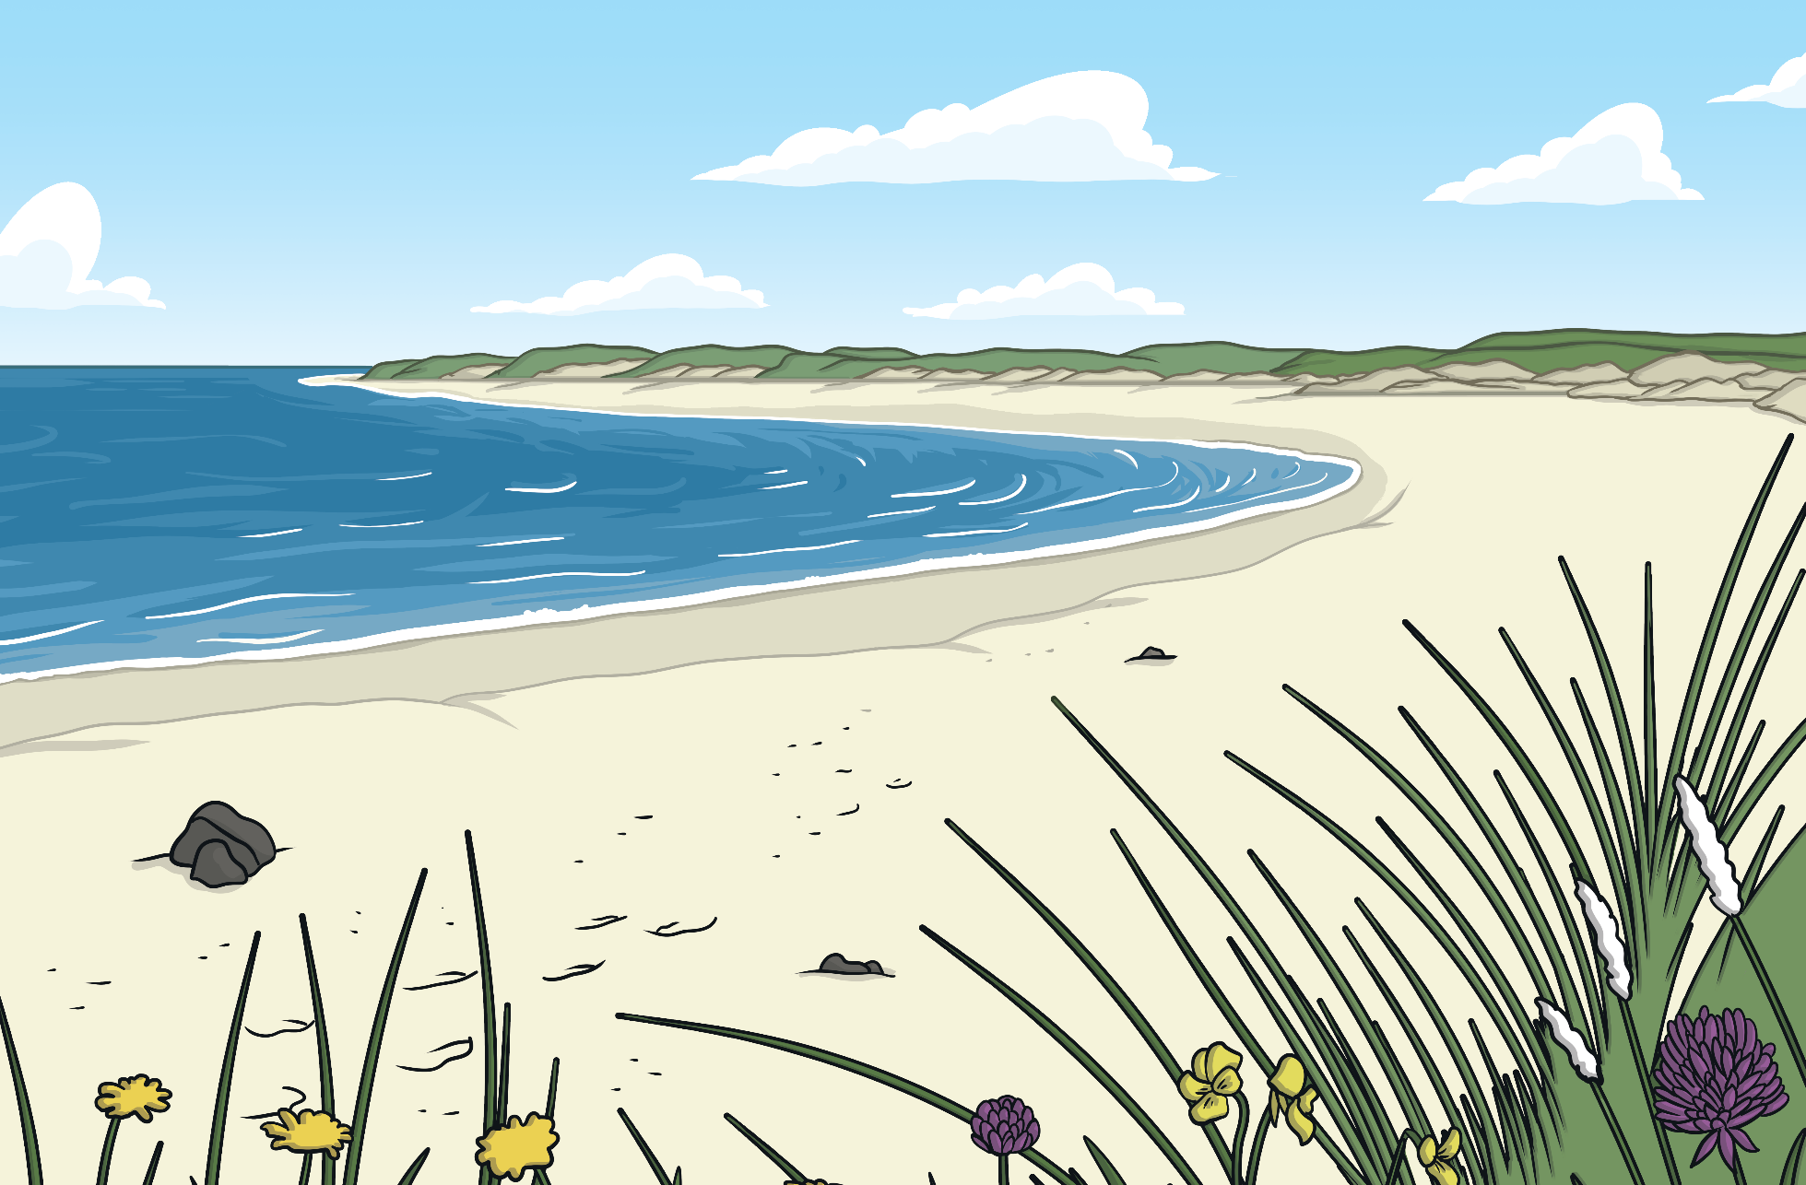
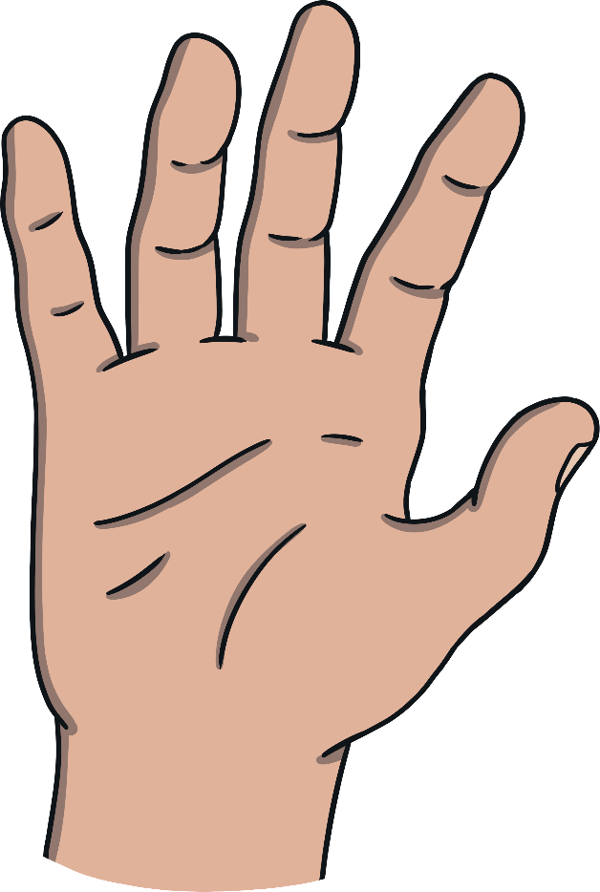

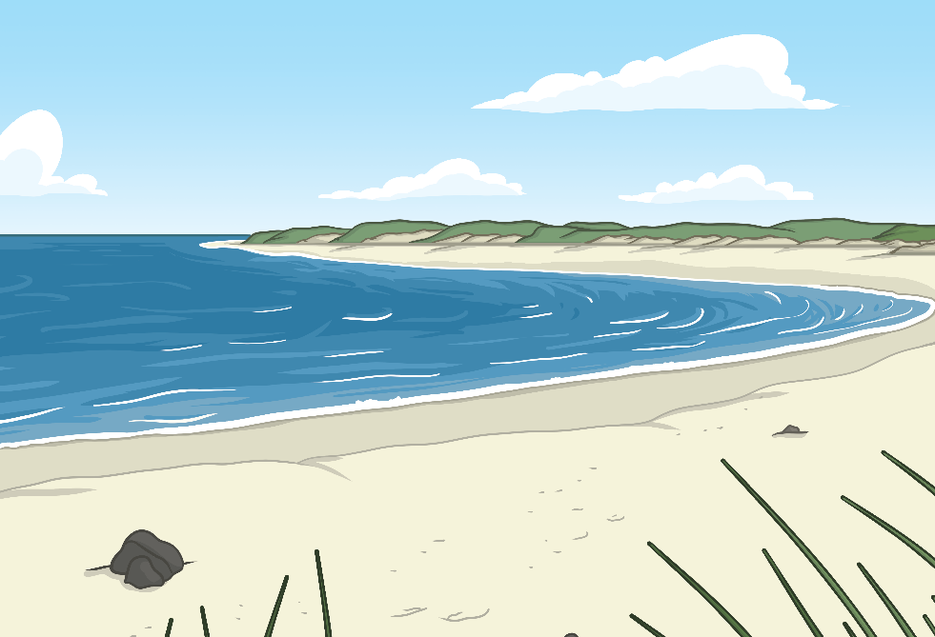


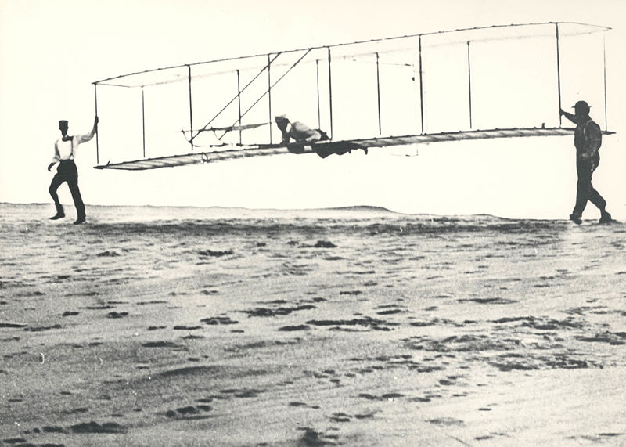
Kitty Hawk
Kitty Hawk
Kitty Hawk is a beach town. Its large sand dunes, sea breeze and soft landing areas made it a great place to practise. The Wright brothers first used kites and then gliders to carry out their tests.
In 1899, the Wright brothers began designing their aircrafts and in 1900, they travelled to Kitty Hawk, North Carolina, to test their inventions.
×
sand dunes - Large hills made of sand.

Slide 9
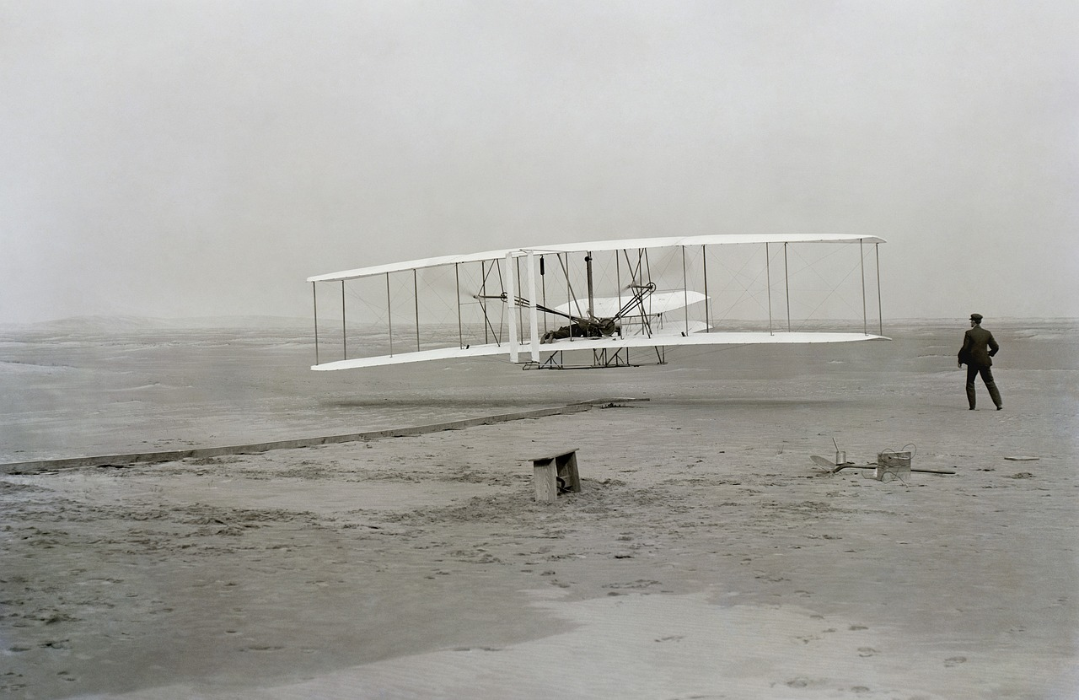
The First Flight
The First Flight
The brothers built their own aeroplane called the Wright Flyer I in 1903. It had wooden propellers and a petrol engine.
At first, the plane wasn’t successful and they spent many weeks struggling to get the plane to fly.
However, on 17th December 1903 the plane finally worked!

Slide 10

The First Flight
The First Flight
Piloted by Orville, it flew for 12 seconds and travelled 120 feet.
Both Orville and Wilbur took turns to fly the plane that day and Wilbur eventually managed to keep the plane in the air for 59 seconds, travelling 852 feet.
Talk About It
What do you think the world would be like without the work of the Wright Brothers?

Slide 11

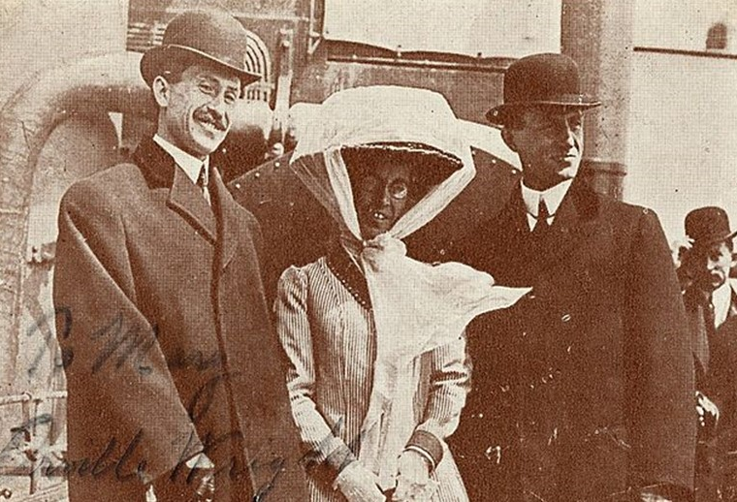
Up, Up and Away!
Up, Up and Away!
By 1905, they had created a plane which was able to stay in the air for 40 minutes.
After the success of their first flight, the brothers became famous around the world.
In 1908, they managed to achieve a flight time of 2 hours and 20 minutes.
They continued to make aeroplanes and worked with their sister, Katherine, to sell them in Europe and to the U.S. army.

Slide 12
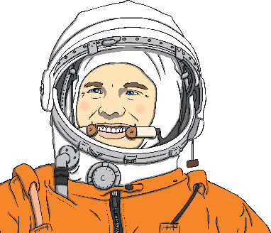
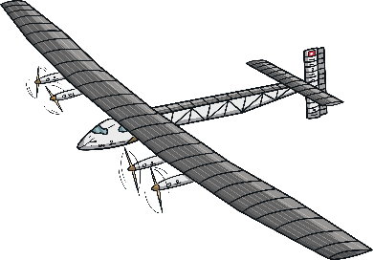
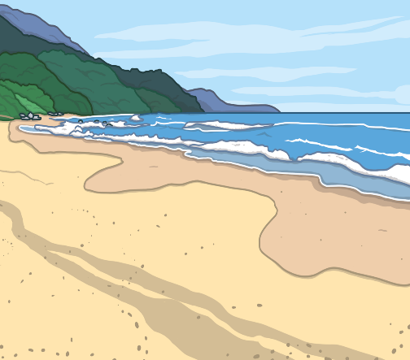


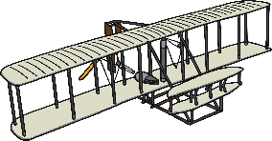
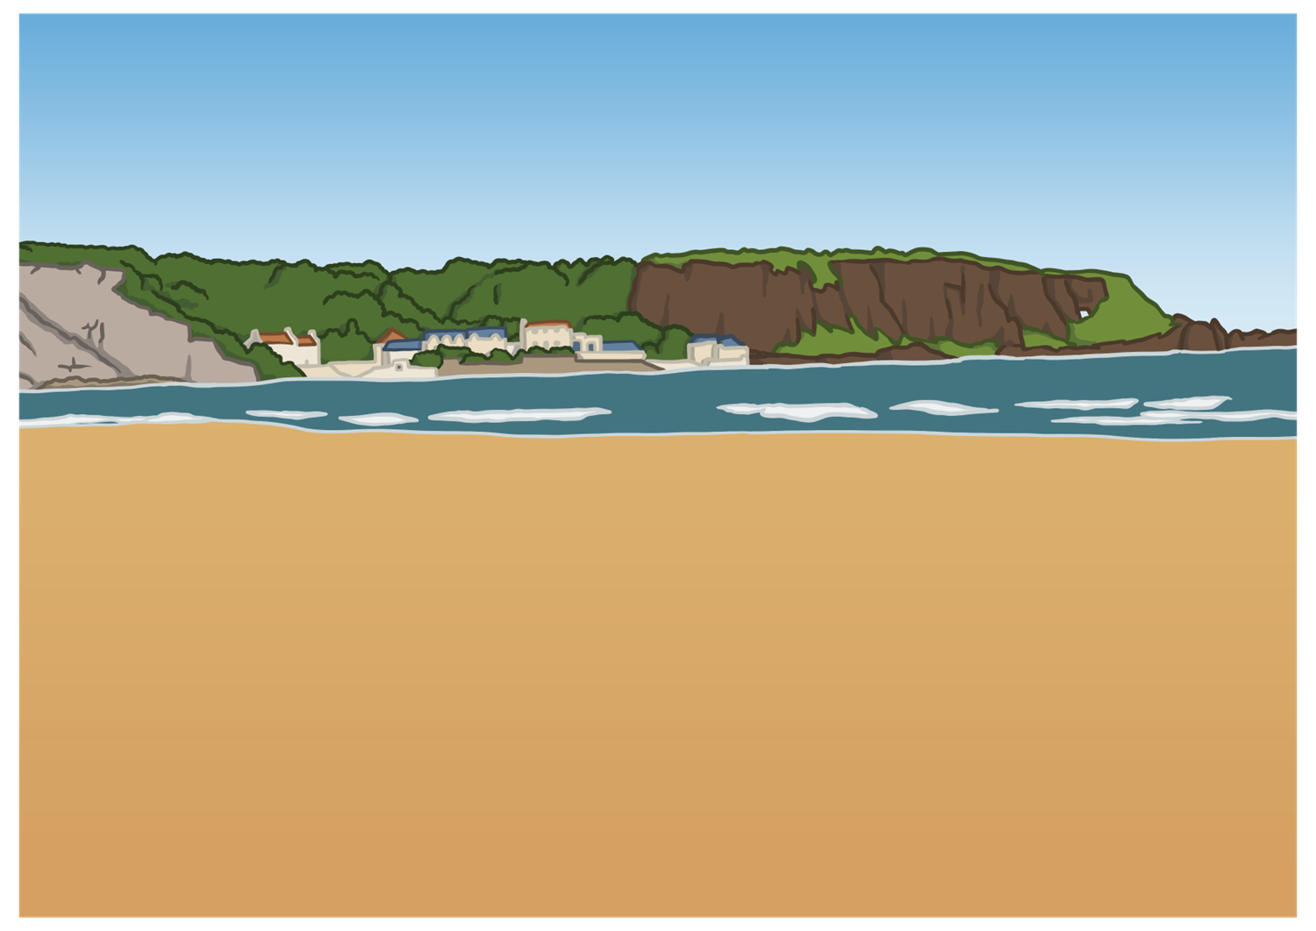
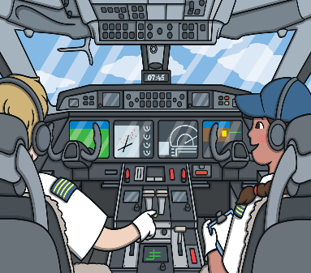
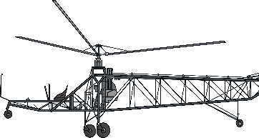
History of Flight After 1903
History of Flight After 1903
1903
1961
2016
1986
First
non-stop flight around the world
First flight of an aeroplane
First flight into space
First solar-powered flight around the world
Beyond Living Memory
Living Memory
1939
1970
2017
Space-X launches first spacecraft
made fully of recycled materials
First flight of
a helicopter
First airline flight of Boeing 747 carrying passengers

Slide 13





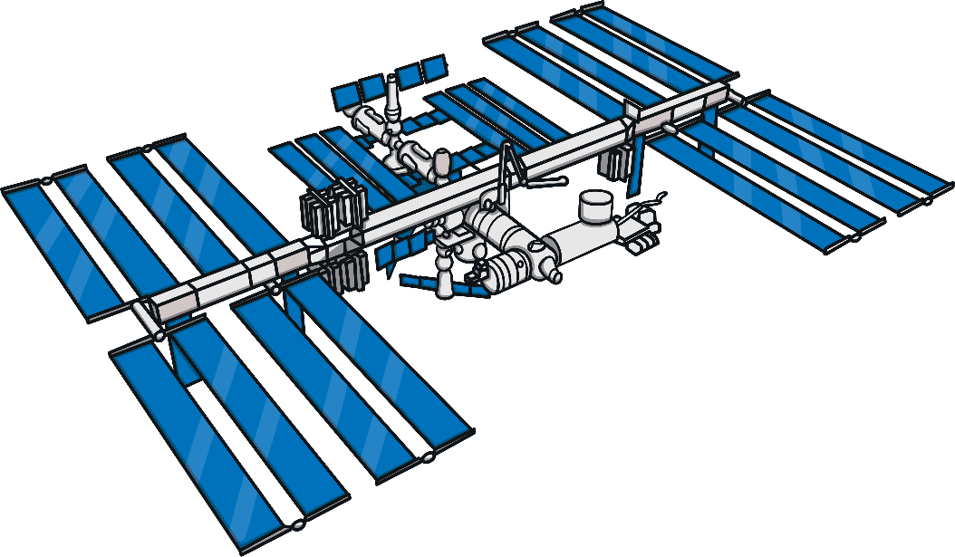
Talk About It
Talk About It
What have you learnt about the Wright brothers?
What do you think will happen in the future with air and space travel?
What lessons do you think we can learn from their work?

