Slide 1
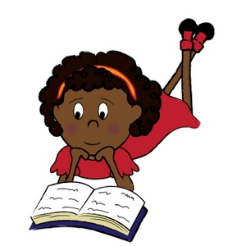
Year 1
Phonics
Screening Check
June 2022
Phonics Screening

Slide 2
Phonics Screening
What is Phonics?
Children are taught to read by breaking down words into sounds or ‘phonemes’.
They are then taught how to blend these sounds together to hear and read the whole word.
"dog" d-o-g
Some words still have to be learned by sight eg. school, friend, water...
There are more than 40 different sounds in the English Language.
Phonemes= how it sounds grapheme= how its written

Slide 3
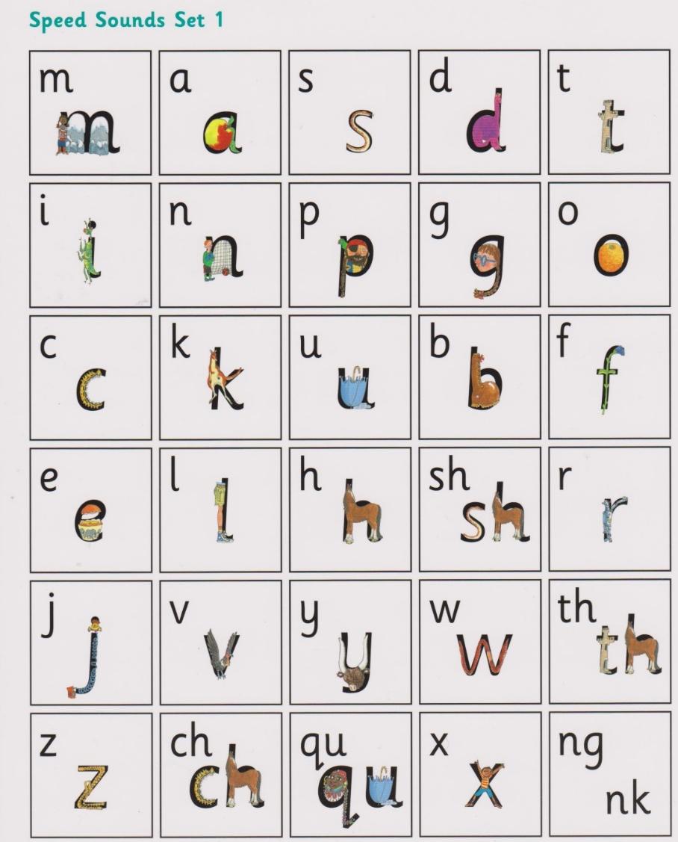
Phonics Screening
There are 40+ sounds or phonemes
These are different to letter names
At Henley Green we use a programme called Read Write Inc to teach phonics
RWI splits phonemes into sets
Pure sounds
Diagraphs: 2 letters can make 1 sound
Set 1

Slide 4
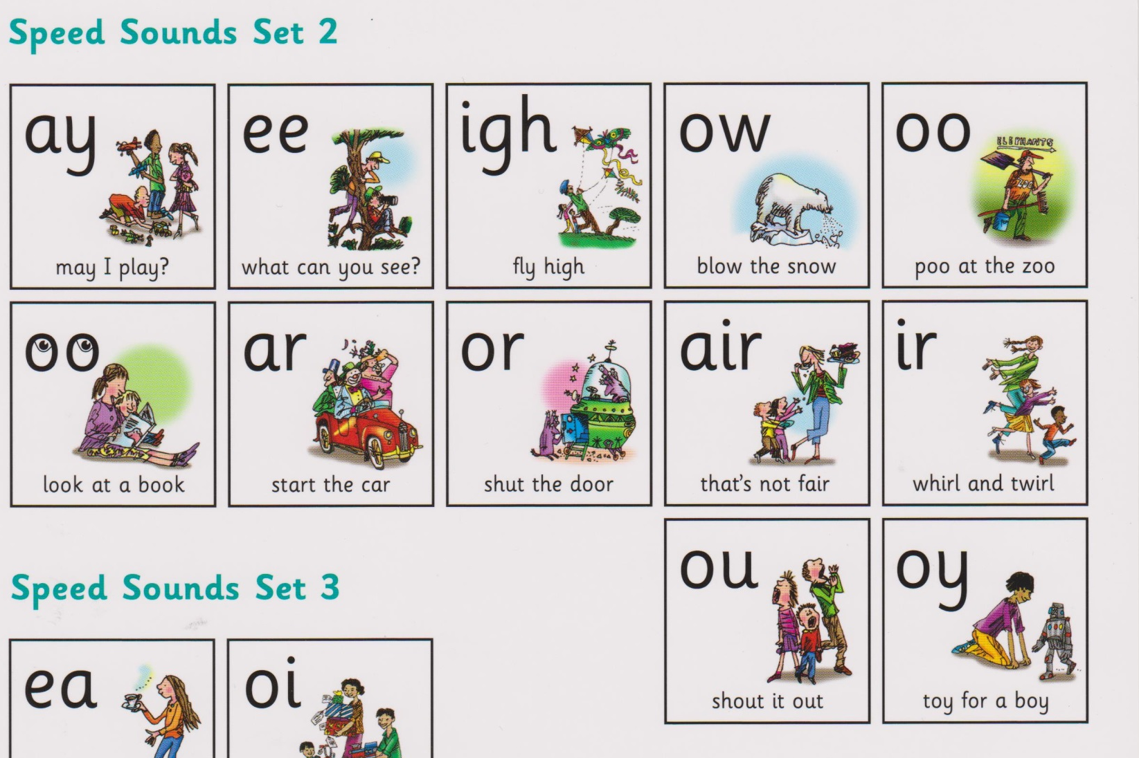
Phonics Screening
Set 2
Used to create the sounds of longer vowels
Diagraphs = 2 letters but one sound
Trigraphs= 3 letters one sound

Slide 5
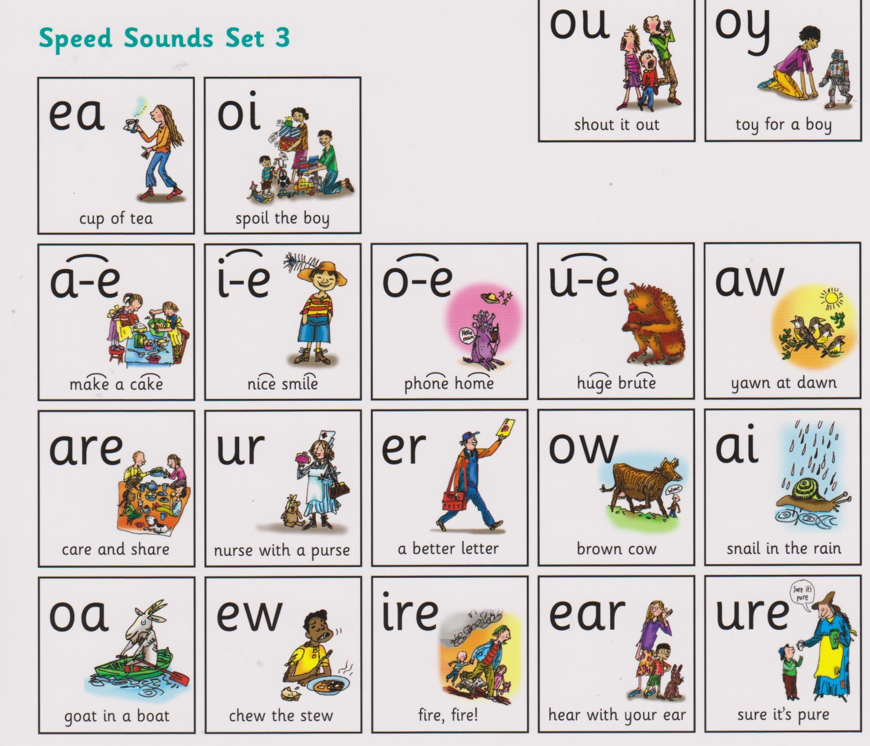
Phonics Screening
Set 2
Split diagraphs- a letter in between the two letters of a diagraph.
Eg. a-e in cake

Slide 6
Phonics Screening
meat bread
he bed
bear hear
cow low
The same diagraphs can be read in different ways.
Children learn through exposure which sound is correct
One phoneme may have several graphemes
"or" "aw" "au"
One grapheme can mean more than phoneme!
Children need to see and hear lots of words to learn the patterns.

Slide 7




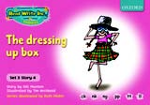







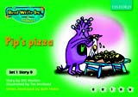




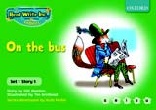

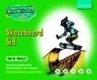
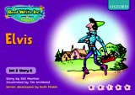


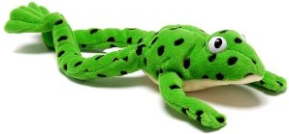
Read Write Inc
Taught from Nursery
Children work in stage groups rather than age
Sounds are taught and reinforced with books and writing.
Regularly assessed and moved groups to fit the need
Fred Talk!
Segmenting and blending sounds to read words

Slide 8
Phonics Screening
c a t
f i sh

Slide 9
Phonics Screening
lawn
cloud

Slide 10
Phonics Screening
cowboy
cow
boy

Slide 11
Phonics Screening
midnight
mid
night

Slide 12
Phonics Screening
The Phonic Screening Check
*Every Year 1 child in the country will be taking the statutory Phonic Screening Check during June 2022.
Most children will do the check in the week of Monday 6th June.
Any children who are absent that week will do the check the following week.
Y2 children who did not pass the Phonic Screening Check will also retake the test during this period and any Y1 children who do not pass this year can retake in a year's time.
The focus of the check is to ensure that all children can read fluently by the end of year 2. The year 1 screening will provide evidence to help teachers plan for year 2 and put support in place.

Slide 13

Phonics Screening
What will the children do?
*The check will take 4 to 9 minutes to complete;
*They will be asked to ‘sound out’ a word and blend the sounds together. e.g. d-o-g – dog. They must do this independently.
*The check will consist of 40 words and non-words
*Children will be told if the word is a real or ‘alien’ word, with a corresponding alien image.

Slide 14


Phonics Screening
Examples of words

Slide 15
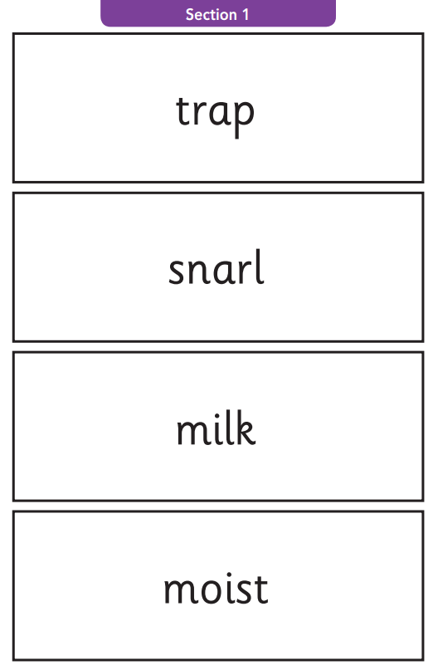
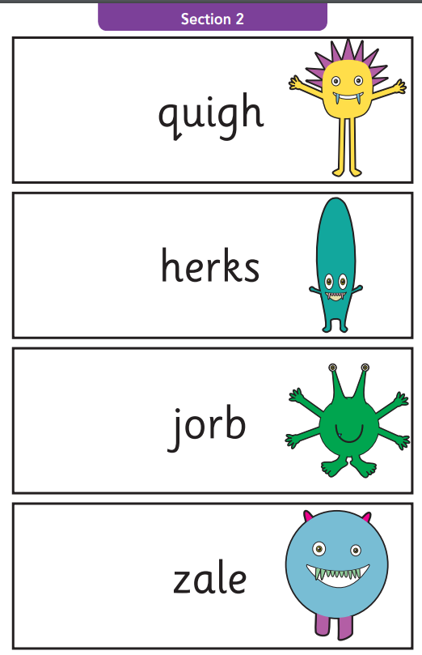
Phonics Screening

Slide 16
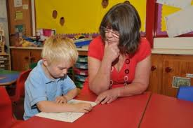
Phonics Screening
How will it be administered?
*Teachers will conduct all of the screening checks with the children. The children are familiar with this routine.
*The children will complete the check one to one in a quiet area of the school.
*We are not permitted to indicate to the children at the time whether they have correctly sounded out and / or blended the word.

Slide 17
Phonics Screening
And the results...?
*The children score a mark out of 40 based on how many words they read correctly.
The pass mark is usually around 32/40.
*We will inform you of the results during the summer term.
*If your child’s score falls below the national standard they will be supported and will complete the screening in year 2.

Slide 18
Phonics Screening
How can you help?
Revising sounds-especially 2 letters, 1 sound (“special friends”) at home.
Supporting with homework – in particular, reading with your child every day.
Websites/ Apps/ Videos:
https://ruthmiskin.com/en/find-out-more/parents/
http://www.phonicsplay.co.uk/
https://parentingchaos.com/phonics-apps-for-kids/
https://www.youtube.com/watch?v=N8wsIajrsZE
https://www.youtube.com/watch?v=-6dSsXkD1wM

