Slide 1
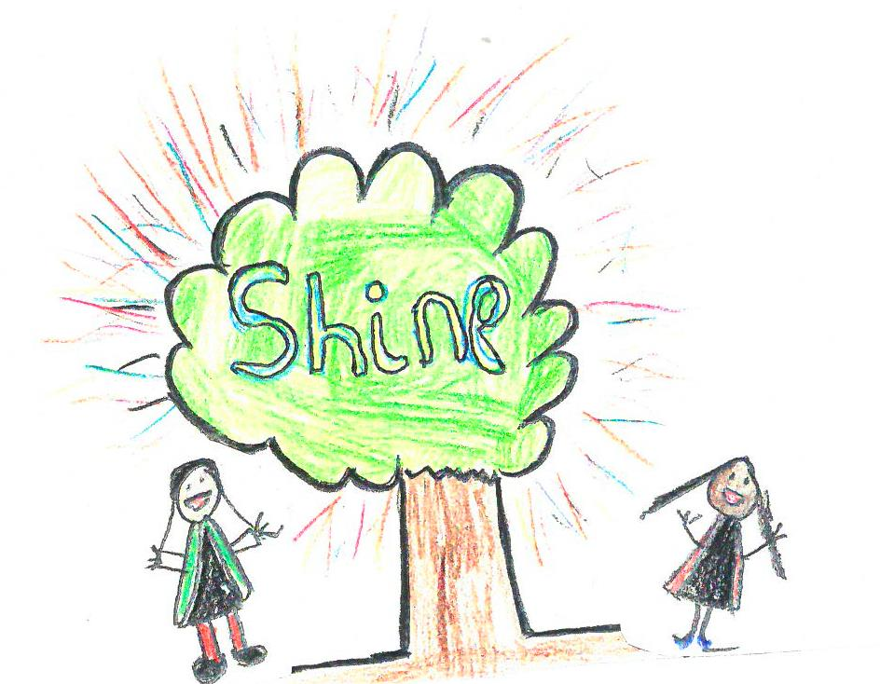
Learning to Read in Reception
September 2024

Slide 2
Phonics and Reading
At Henley Green we teach children to read by breaking down words into sounds or ‘phonemes’. They are then taught how to blend these sounds together to hear and read the whole word.
We use Read Write Inc Phonics to read and write.

Slide 3

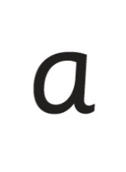

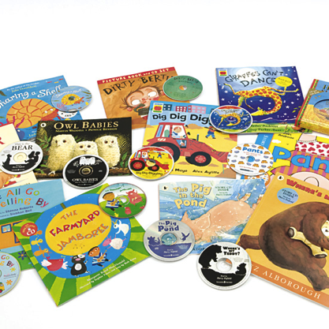





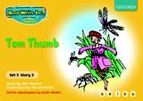

What is Read Write Inc Phonics?
A Systematic approach
sat
mat
p
d
sad
i
t
n
Notes:
Read Write Inc. Phonics is a programme that uses systematic phonics to teach all children to read.
It lasts two years for most children - if they start to learn to read in the Reception class.
(There are some children with learning difficulties who spend longer on the programme.)
Click – We teach the sounds first – in a specific order.
Click – We then teach your children to blend those sounds together in order to read words
Click – The children read words in the matched Storybooks. Each Storybook is carefully matched to the sounds they can already read - setting them up for success.
Click – We read to children ‘real’ books’. Once they have learnt to read, they will be able to independently read these books for themselves.

Slide 4
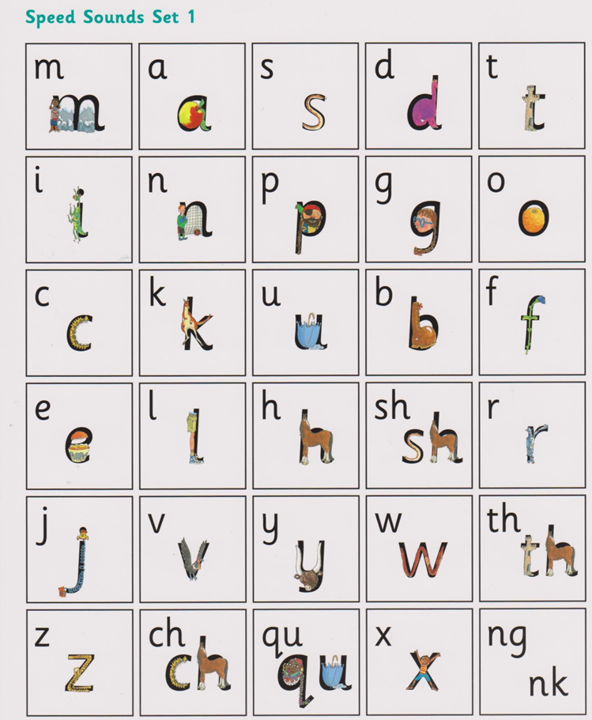
The Speed Sounds – Set 1

Slide 5
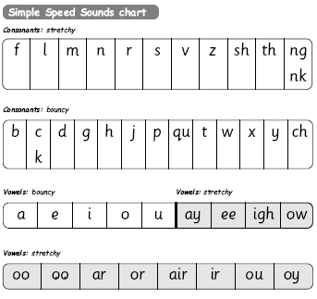
Simple Speed Sounds
Notes:
Phonics makes learning to read easy for children because we start by teaching them just one way of reading and writing every sound. Here they are on the Simple Speed Sounds chart.
We teach Set 1 sounds first - (sounds as far as a e i o u) and then Set 2 (the shaded sounds ay - oy).
Use MTYT to teach each of the pure sounds to parents.

Slide 6
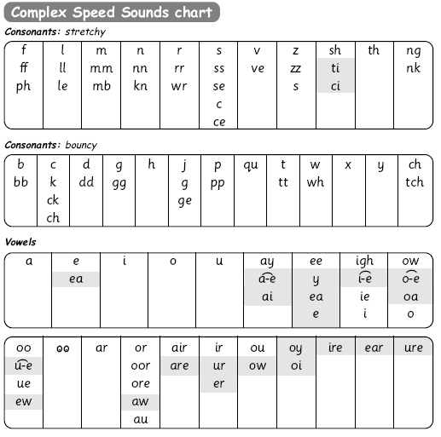
Speed Sounds chart
Notes:
We use this Speed Sounds chart in Phonics lessons.
It shows the most common graphemes for each sound.
Each box is a sound box showing different ways to read and write the sound. Demo the ‘f’ sound box with examples of words ‘fun’, ‘huff’, ‘photo’ and the ‘or’ sound box with examples of words ‘or’, ‘door’, ‘more’, ‘dawn’, ‘author’.

Slide 7
Simple Speed Sounds
Notes:
Phonics makes learning to read easy for children because we start by teaching them just one way of reading and writing every sound. Here they are on the Simple Speed Sounds chart.
We teach Set 1 sounds first - (sounds as far as a e i o u) and then Set 2 (the shaded sounds ay - oy).
Use MTYT to teach each of the pure sounds to parents.

Slide 8
Speed Sounds chart
Notes:
We use this Speed Sounds chart in Phonics lessons.
It shows the most common graphemes for each sound.
Each box is a sound box showing different ways to read and write the sound. Demo the ‘f’ sound box with examples of words ‘fun’, ‘huff’, ‘photo’ and the ‘or’ sound box with examples of words ‘or’, ‘door’, ‘more’, ‘dawn’, ‘author’.

Slide 9

Blending using Fred Talk
p
sat
d
mat
i
t
sad
n
Notes:
Once the children know the pure sounds, we teach them to blend sounds to read words. We also teach children to spell the words they learn to read.
We use Fred Talk to help children read and spell words.
This is Fred.
He is a frog who can only speak in sounds, and we call this Fred Talk. For example ‘m’ ‘a’ ‘t’, ‘l’ ‘u’ ‘n’ ‘c’ ‘h’.
He helps children sound out words so they can read and spell.
MTYT some examples with the parents. For example ‘m’ ‘a’ ‘t’ mat, ‘s’ ‘a’ ‘t’ sat.

Slide 10
Storybooks
Notes:
Alongside learning each set of sounds, they read Storybooks that only contain the sounds and words they can read. This sets them up to succeed in their reading.
We discuss and write about the ideas in these Storybooks.
We also teach children to read common exception words – words like ‘said’ and ‘they’.

Slide 11

Reading at school and at home
At School:
They are taught reading every day through Read Write Inc
At home:
We expect every child to:
bring their reading materials into school each day
to read every day at home
and that this is noted in their Reading Record by whomever has read with your child.

Slide 12
We expect children to read at home EVERY DAY
This might be:
sharing their home-school reading book
sharing a book from home/the Library
listening to a story you are reading to them
We are happy for children to read with or to parents, grandparents, older brothers and sisters, uncles and aunts, cousins and family friends and this can be for as little as 5-10 minutes a day.
.

Slide 13
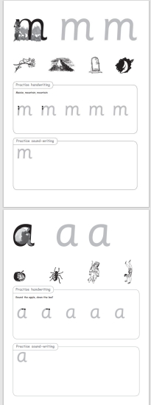
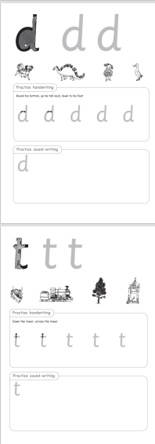


Slide 14
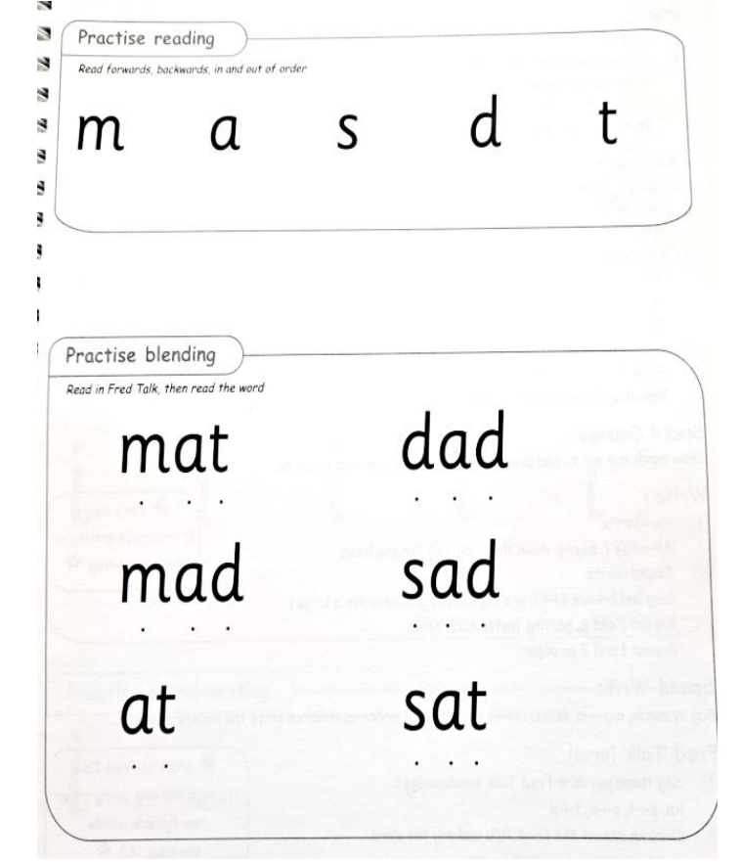


Slide 15
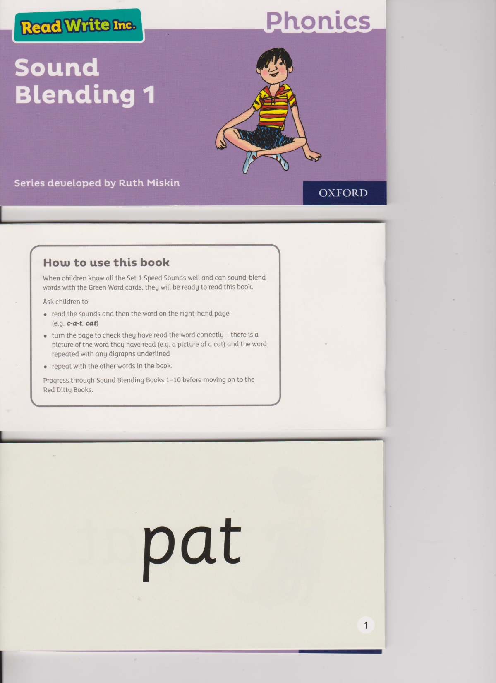
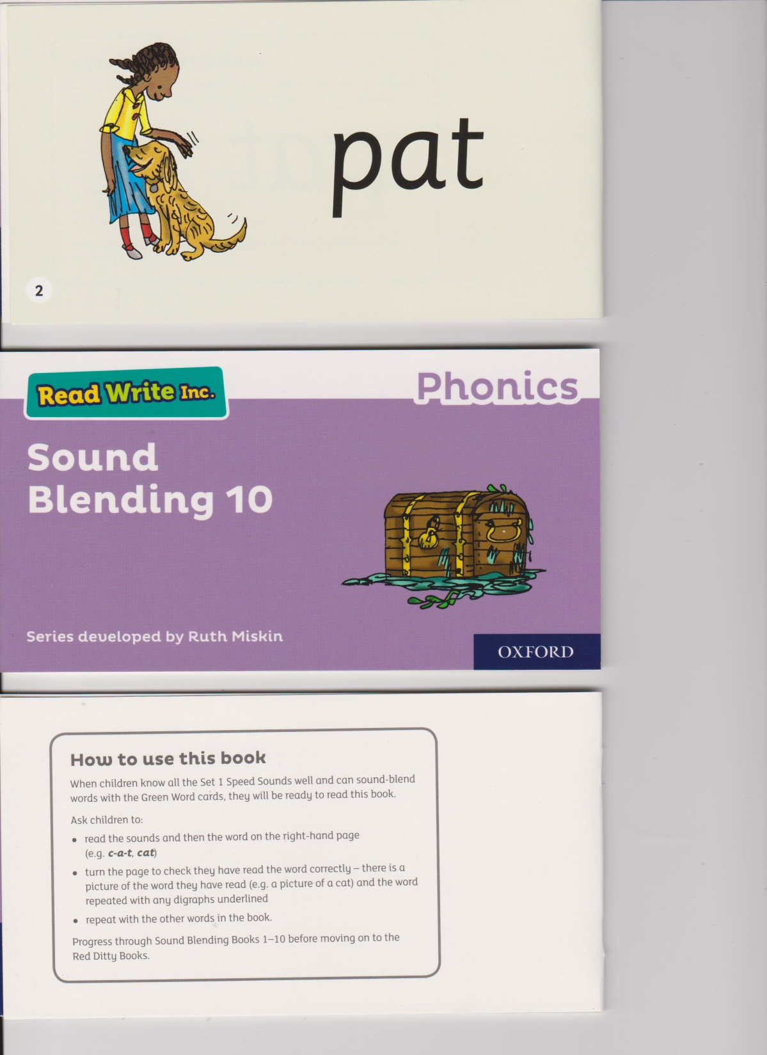

Slide 16

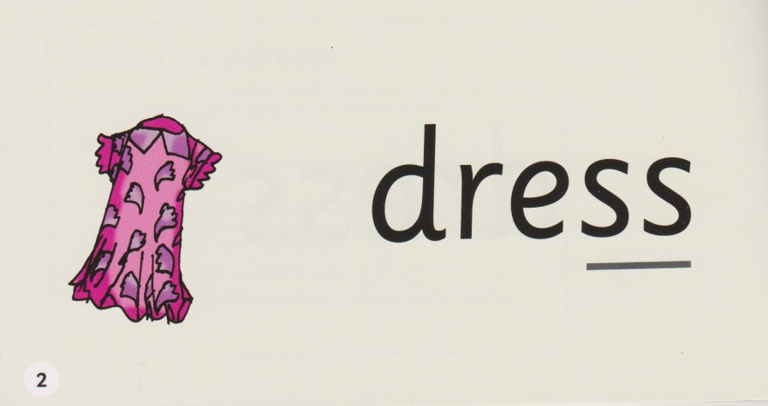

Slide 17
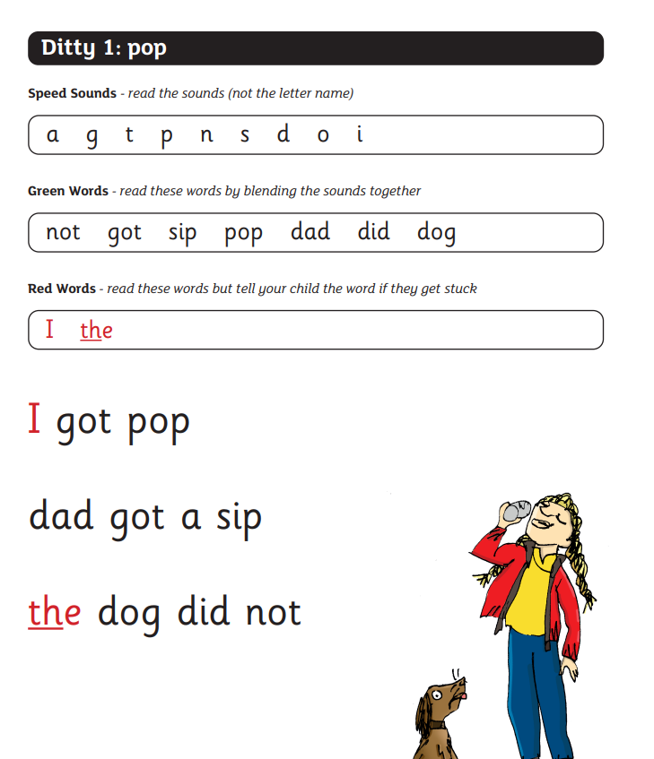

Slide 18
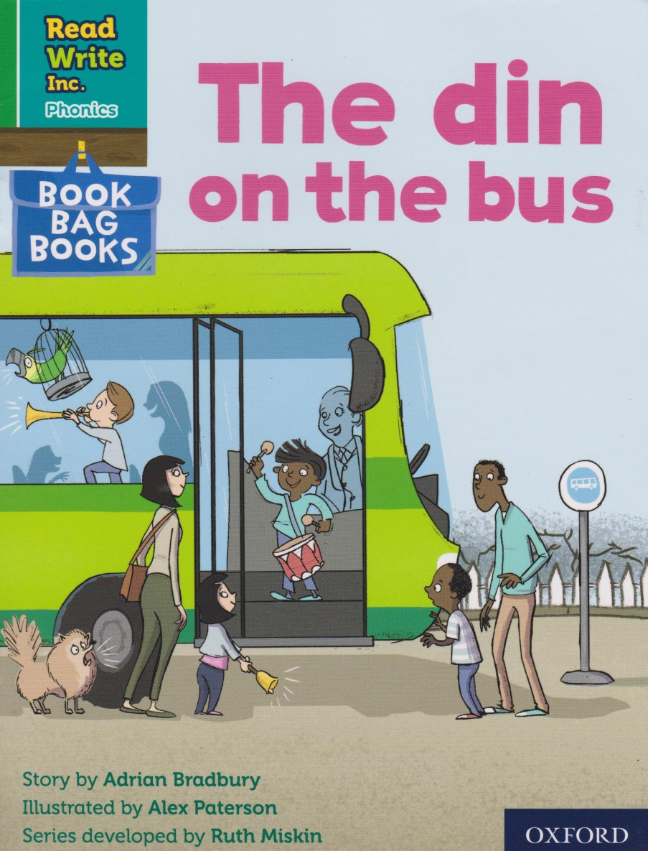
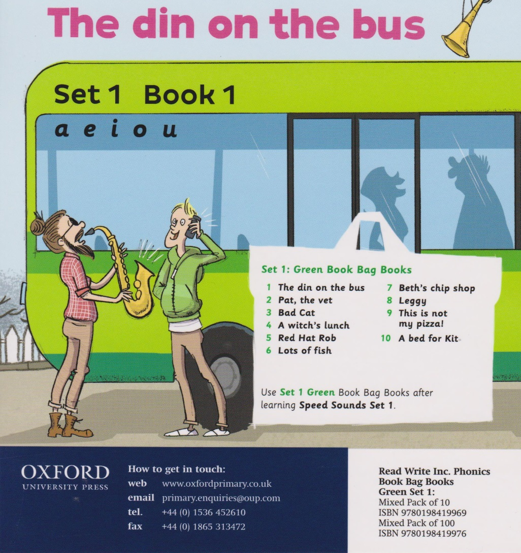
Front Cover
Back Cover

Slide 19
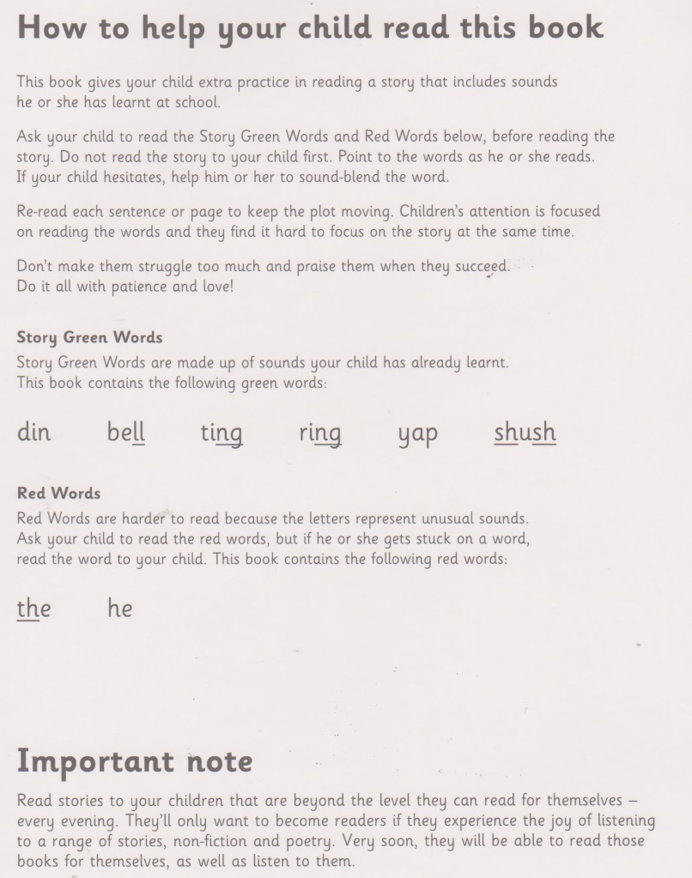

Slide 20
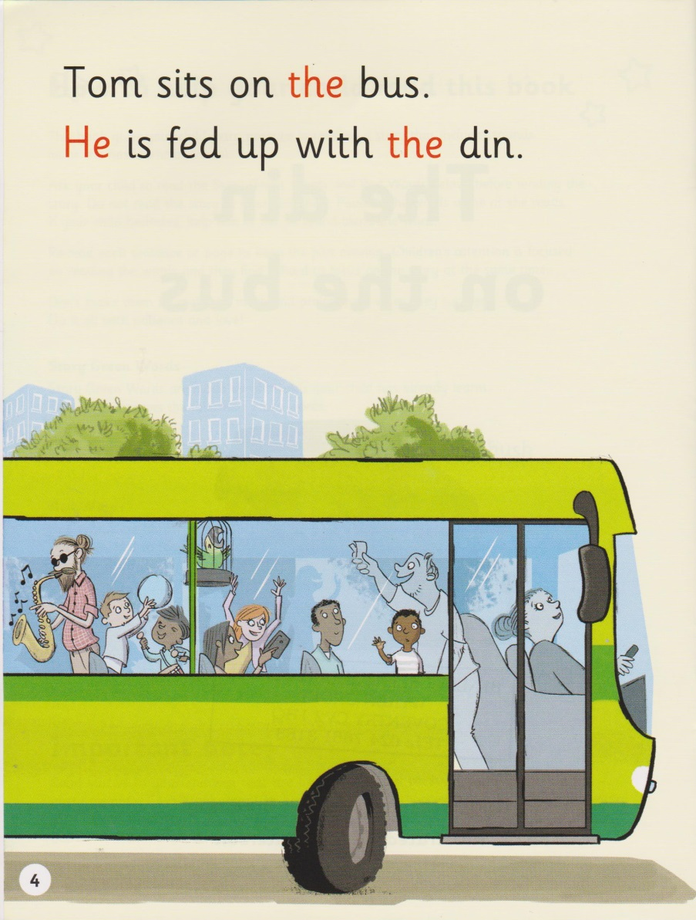
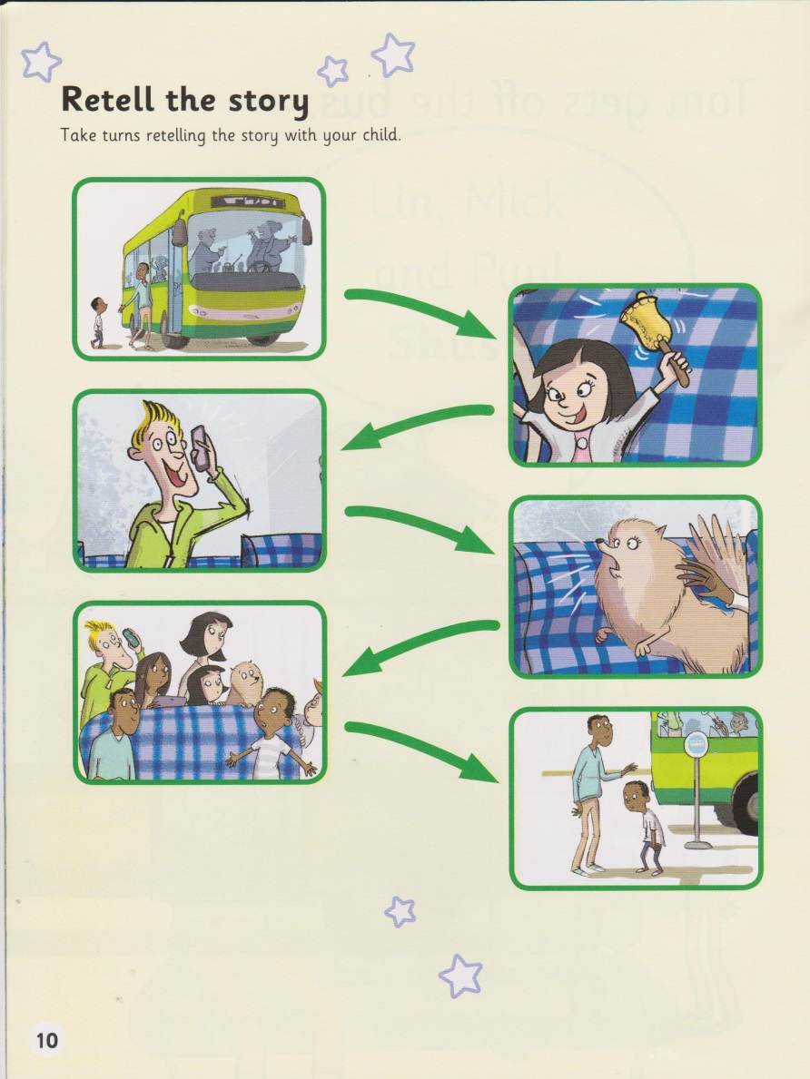

Slide 21
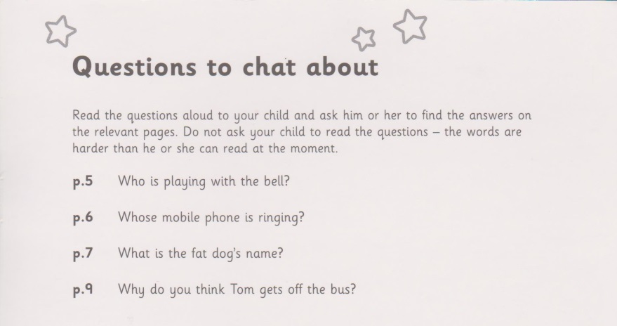

Slide 22
Read to your children
Ask lots of questions and share opinions
Talk to your child as much as possible and ‘feed’ them new and ambitious vocabulary.
Support how your child is learning to read and spell in school
    Pure sounds
    Fred Talk – “it’s time for b-e-d”
    Fred Fingers
Notes:
One of the most important things you can do as a parent at home is read higher level texts to your child.
This helps develop an enjoyment for stories and the motivation for learning to read themselves.
Ask questions and share opinions about what you read to engage them in discussion, get them thinking about what they read and develop vocabulary.
Click and read.

Slide 23
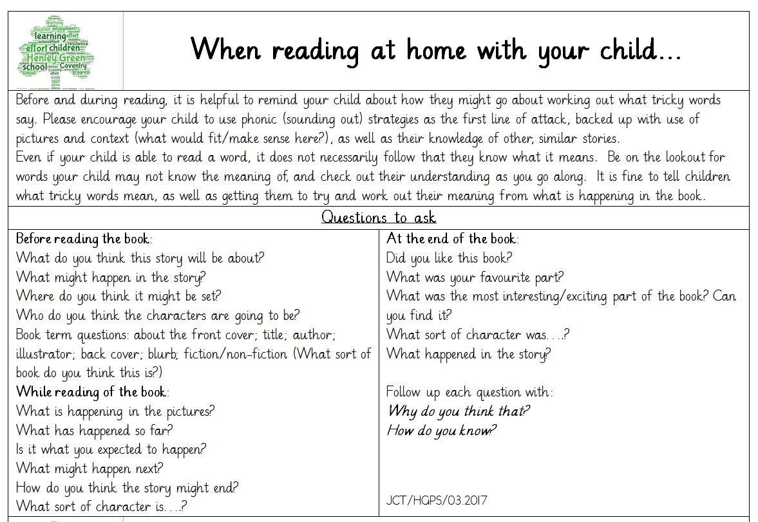

Slide 24
The Importance of Talk
Turn-taking balanced turn-taking is vital to not only holding the attention of young children, but seeing them develop their language and social skills.
Expanding and rephrasing When your daughter says “It’s big car” – you can expand upon it and rephrase a little too, “Yes – it is a big, red car – isn’t it enormous?”
Extending and explaining. Explaining stuff, such as what is going to happen at the shops, or what happened on holiday last year, is the type of extended talk and language that has a positive impact on a child’s vocabulary developing successfully.

